Slide 1


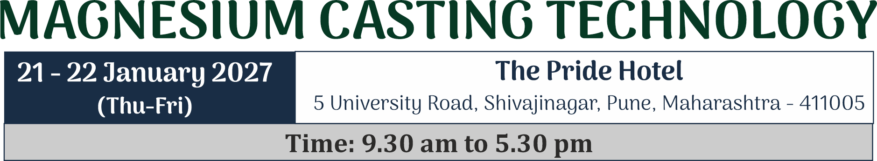
Welcome
TO THE MAGNESIUM FRATENITY
FOR
3rd International conference on

Slide 2
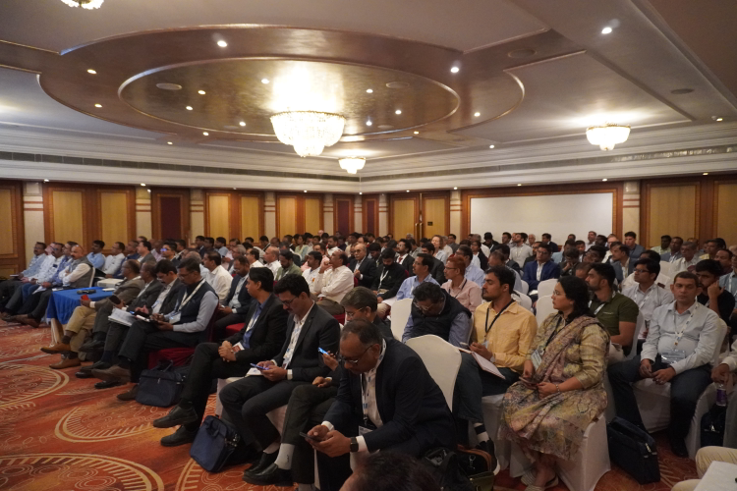
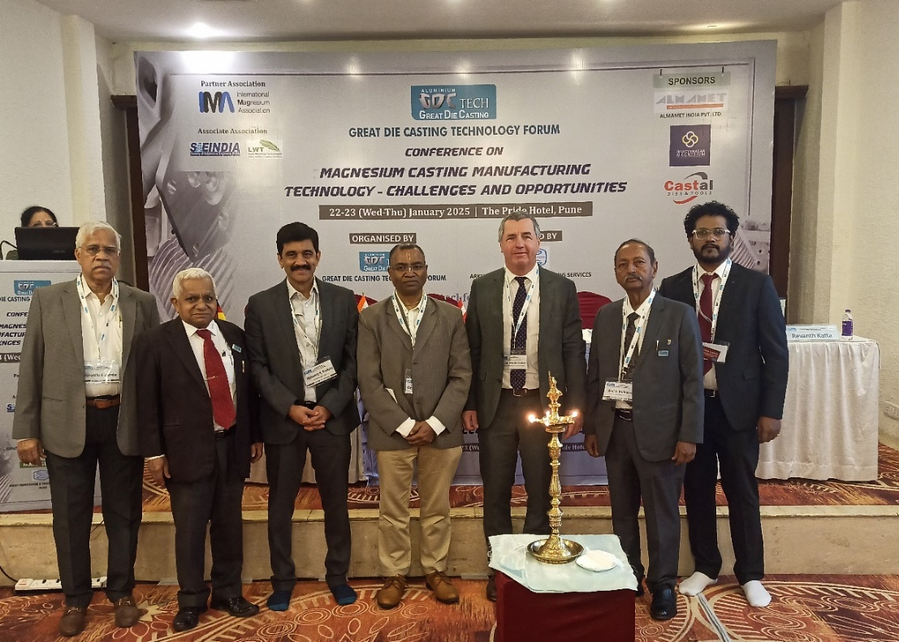
Glimpses of earlier Two Conferences
on Magnesium Casting Technology

Slide 3
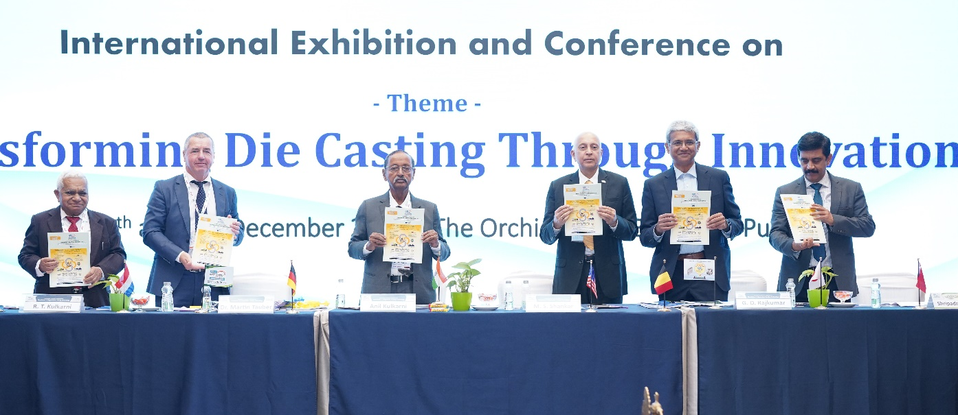
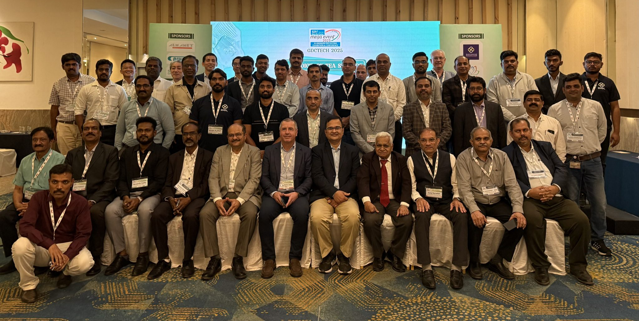

Slide 4
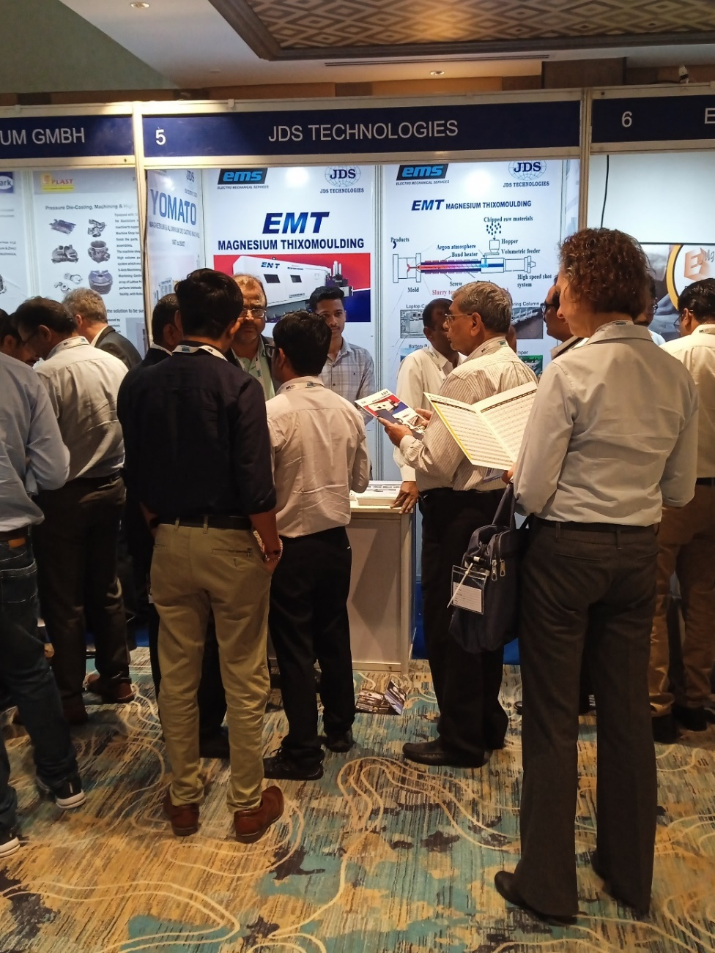
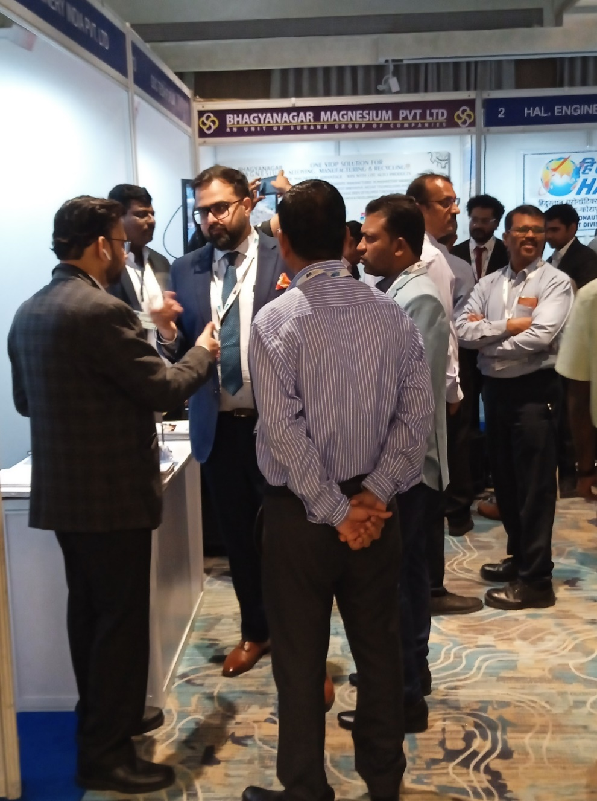

Slide 5
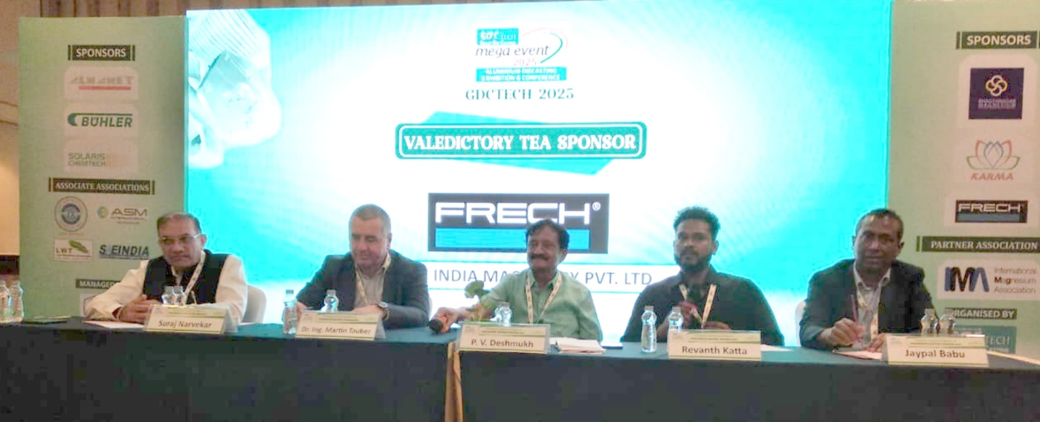
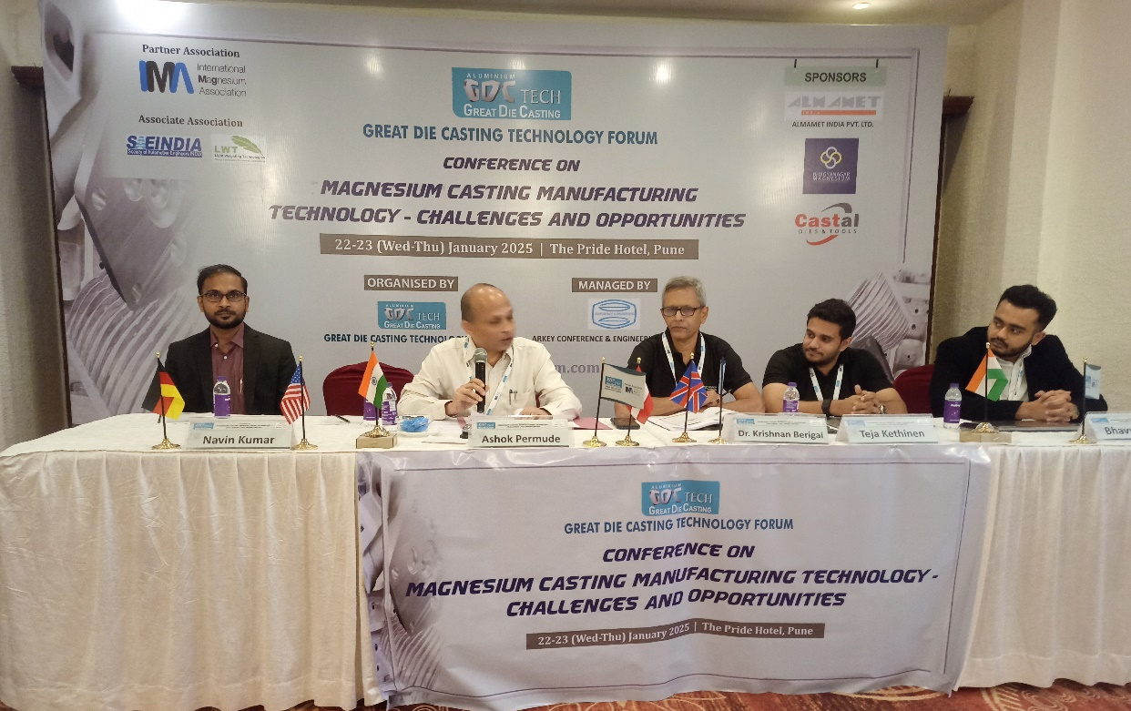
PANEL DISCUSSIONS

Slide 6
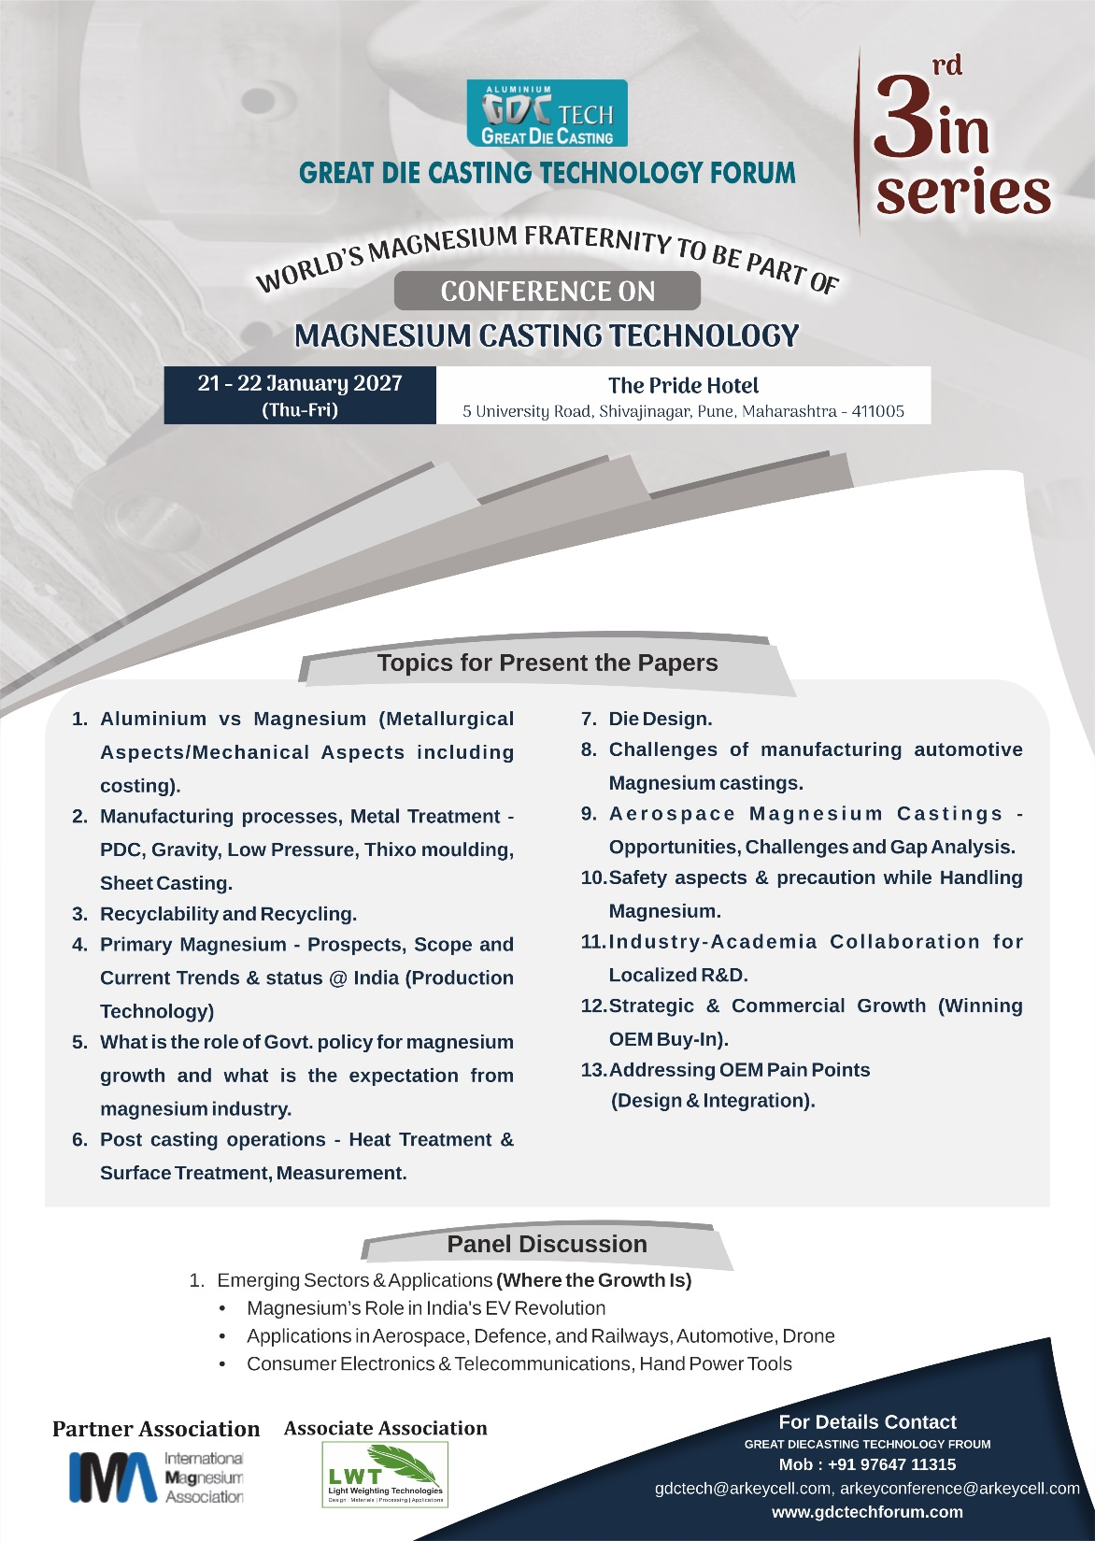

Slide 8
CONFIRMED AUTHORS LIST
1. Magenisum Thixomolding Technology
Mr. Danny Wu, Head of Project Department
BOLE INTELLIGENT MACHINERY
2. How Market Generation Actually Works For Magnesium Castings
Mr. Fabian Niklas, CEO
CASTING-CAMPUS GMBH
3. Game Changer Plasma: Eliminating the Compromise between Weight and Durability with ULTRACERAMIC® Magnesium
Mr. Diellza Lokaj, Project Management
CERANOD
4. Aluminium Vs Magnesium (Metallurgical Aspects/Mechanical Aspects including costing)
Dr. Krishna Kumar, Senior Scintist
CSIR NATIONAL METALLURGICAL LABORATORY
5. Corrosion of Magnesium Alloys: Mechanisms, Challenges, and Opportunities for Advanced Engineering Applications
Dr. Sourav Ganguly, Scientist-D,
CSIR-IMMT

Slide 9
CONFIRMED AUTHORS LIST
6. Leaping forward with Magnesium-Thixo moulding
Mr. Paolo Milanese, Sales Director Europe
HAITIAN ZHISHENG DIE CASTING EQUIPMENT CO. LTD.
7. Optimizing Magnesium Die Casting Performance Through Advanced Process Fluids: From Die Face Lubricants to Precision Metal Cutting Fluids
Mr. Kavi Israni, DGM
HARDCASTLE PETROFER PRIVATE LIMITED.
8. Revolutionising Indian Aerospace : Low Pressure Sand Castings for Complex Magnesium and Aluminum Components - Overcoming Limitations of Gravity Castings
Mr. Martin Rauch, CEO
RAUCH FURNACE TECHNOLOGY GMBH
9. X-Ray & Industrial C T Quality Inspection Solutions for Magnesium Alloy Components
Mr. Karthikeyan Jawahar, Director
KARMA INNOVATIONS & SOLUTIONS PVT.LTD.

Slide 10
CONFIRMED AUTHORS LIST
10. Selection of Best Die Steel Material for Magnesium Die Casting with Comparision with other 1 or 2 regular Steels
Dr. (NSW) Petra Becker
KIND & CO. EDELSTAHLWERK, GMBH & CO.KG
11. Primary Magnesium in India: A Strategic Metal for Automotive, Aerospace and Defence
Mr.Vishal Shah, Managing Director
MESO CARBON INDIA PVT. LTD.
12. Safety in Magnesium Industry With lot of general miss conceptions at the shop level
Dr. Krishnan Berigai, Principal Technical Advisor
TK VELOCITY WHEELS PVT. LTD.
13. Aluminium vs Magnesium Wheels
Dr. Shamsunder, Managing Director
AGANITA VENTURES PVT.LTD.

Slide 11
CONFIRMED AUTHORS LIST
14. Engineering the Transition - Aluminum to Magnesium Conversion- opportunities, outcomes,
challenges and cost O2C2
Mr. Revanth Katta, Executive Director
BHAGYANAGAR MAGNESIUM PVT. LTD.
15. Up-date on the global Magnesium Industry
Martin Tauber
European Representative (IMA).
16. Advanced Applications of Magnesium Alloys in Drones, Robotics and Biomedical
Implants
Subh Charan N
Consultant
17. Enhance Mg alloy coating performance by Bonderite surface
treatments
Mr. Ashok Konduskar Henkel Adhesive Technologies India Pvt.Ltd.

Slide 12










PAPERS CONFIRMED BY

Slide 13
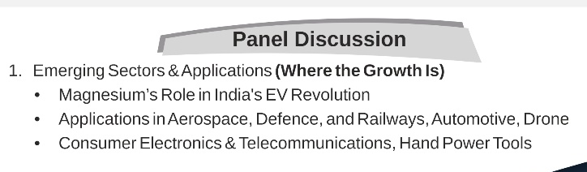

Slide 14
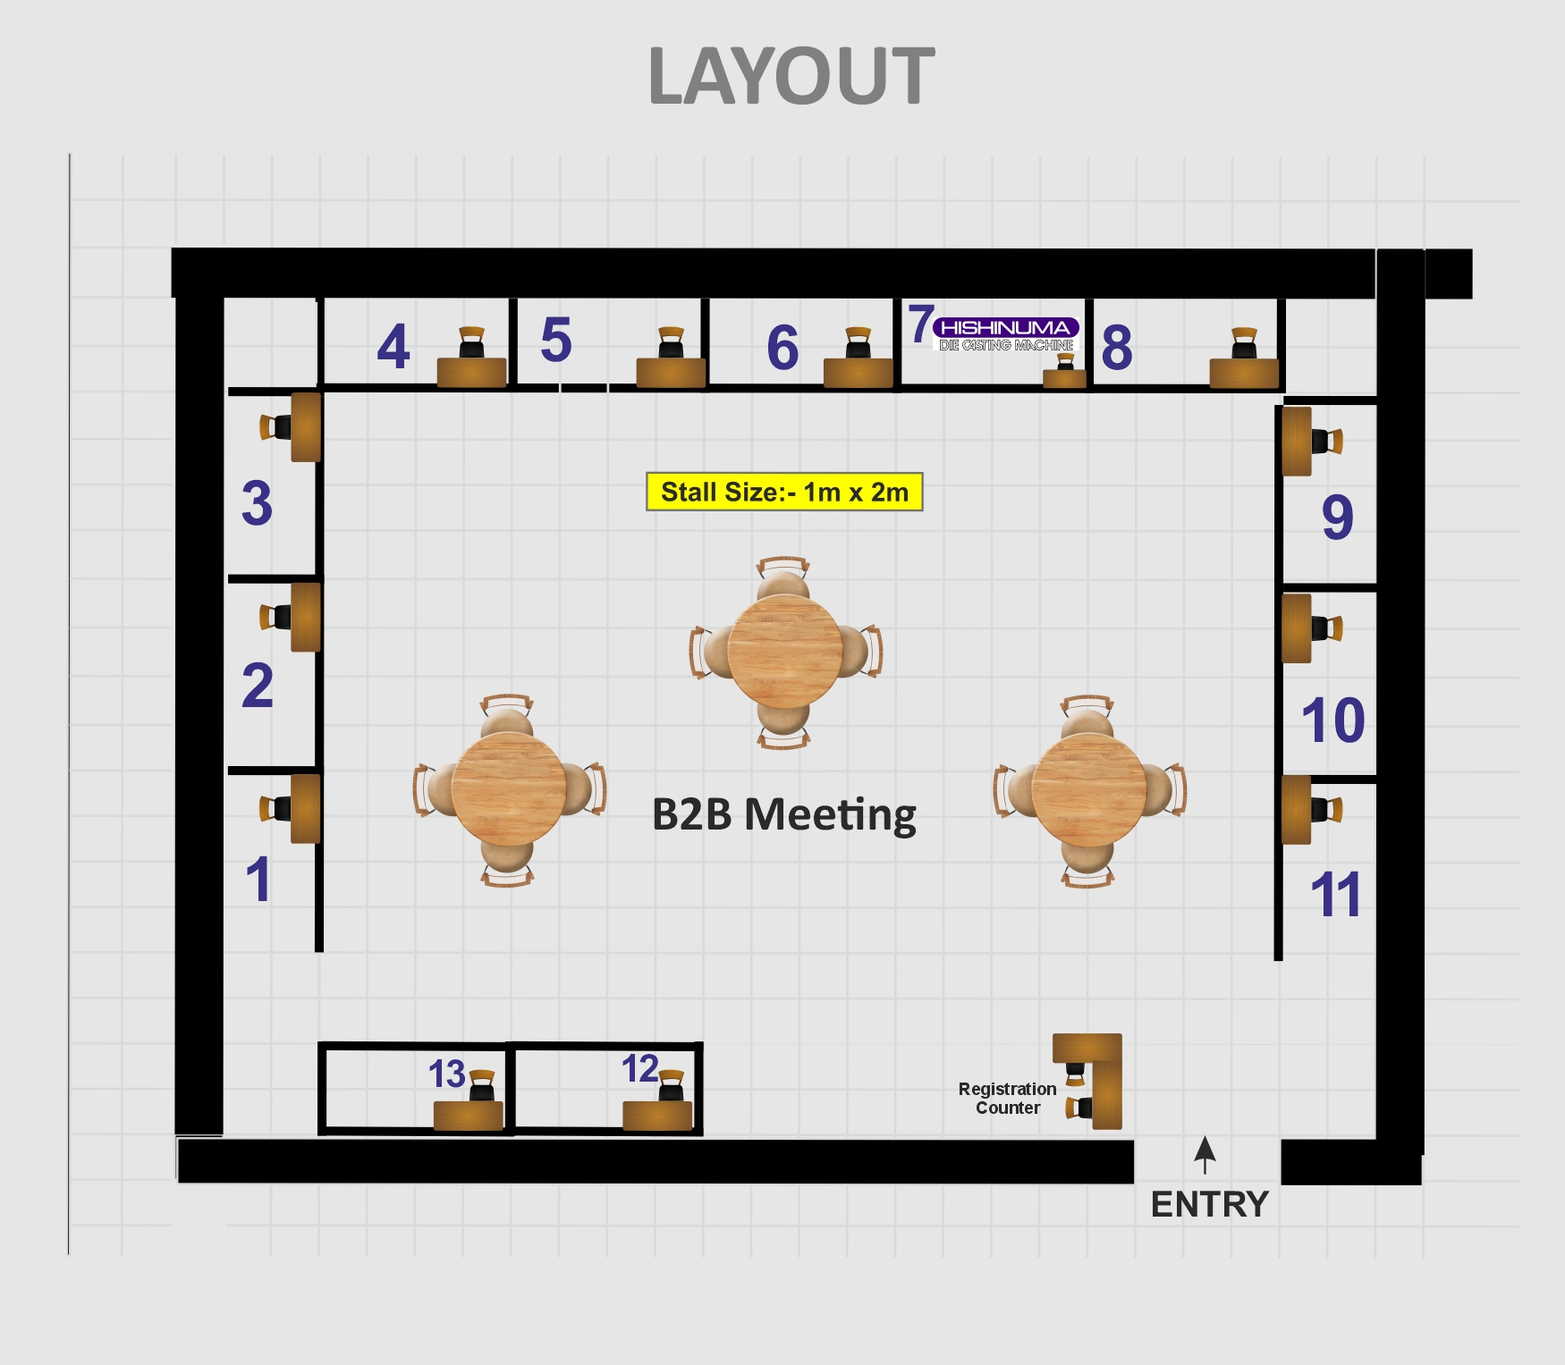
Ditta Musto has shown interest to participate in Exhibition

Slide 15
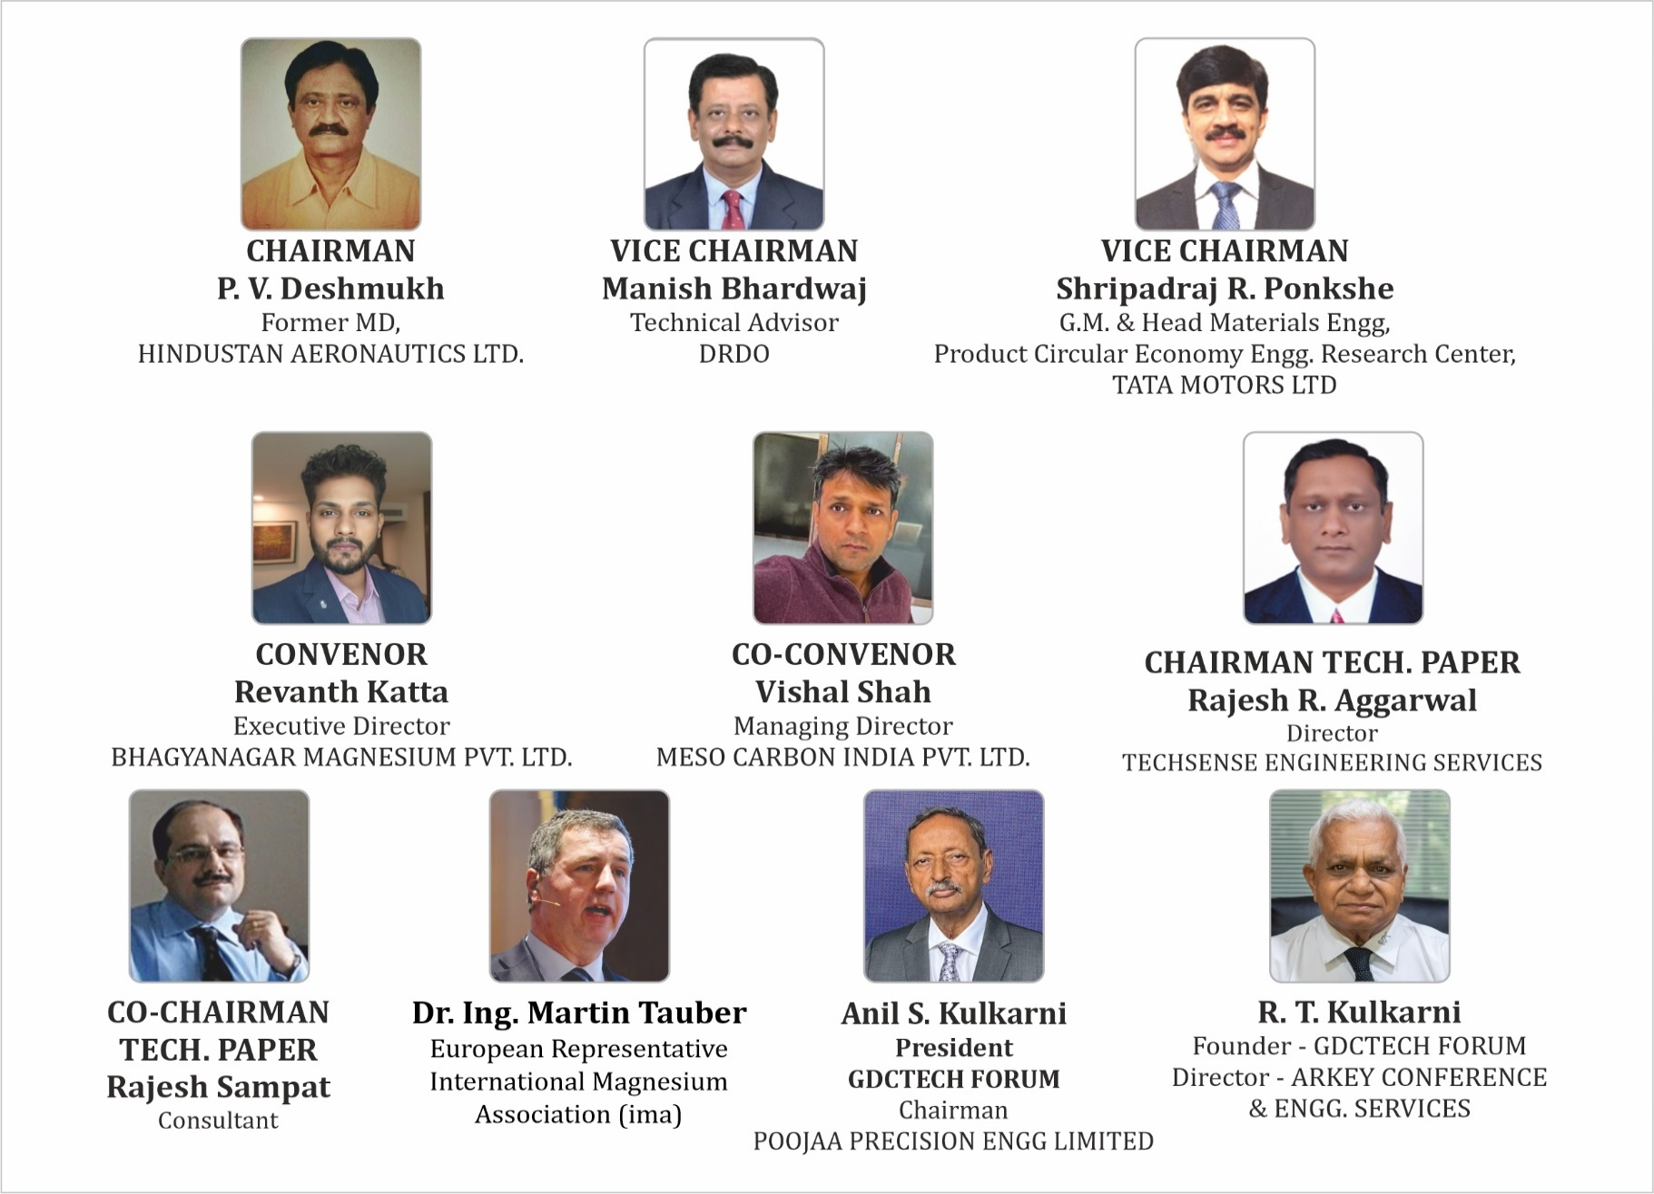

Slide 16
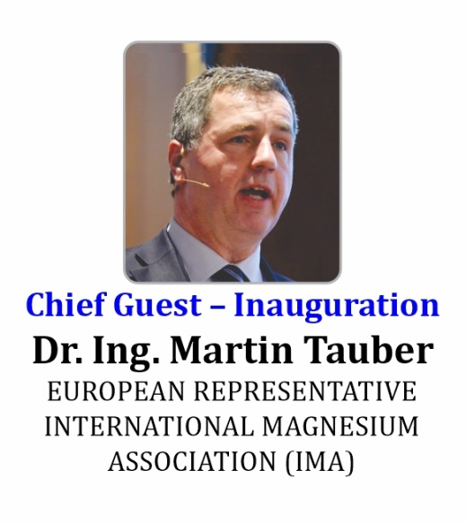
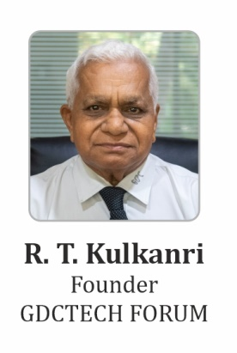
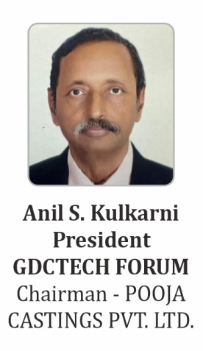
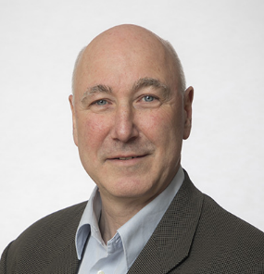
President of GDCTECH
European Representatives
Founder
Dietmar Letzig
European Committee Chair

Slide 17
We invite to join the event as a
Speaker
Sponsor & Exhibitor
Delegate

Slide 18
Contact :
GREAT DIECASTING TECHNOLOGY FORUM (GDCTECH)
Organiser – Magnesium Conference
37/4/A, 6th Lane, Prabhat Road, PUNE – 411 004
Email id-gdctech@arkeycell.com
Mobile: 9764711315

Slide 19


